Slide 1
Community Belonging Survey
By:
WOU OL 636 – Data-Driven Decision Making
Alejandra Sanchez-Urquiza, Alexis Williams-Kackle, Casey Stephens, Kamahoi Sanchez, and Timothy Machado
With Instructor Marianne Bradshaw
In Partnership with:
City of Salem Human Rights Commission (HRC)
June 2023

Slide 2
Research Objectives
To measure:
Perceptions of Salem as a welcoming community
Experiences, types, frequency, and location of first-hand and second-hand discrimination
Perceptions of discrimination level in Salem
Awareness of HRC
Comfort level for reporting a bias crime to the SPD
Experiences and perceptions among people who are experiencing homelessness.

Slide 3
Methodology
Self-administered online questionnaire
Hard copy option
26 questions
Field open May 5-16, 2023
Available in English and Spanish
(Attempted Chuukese and Marshallese)
# of Respondents for Analysis: 574

Slide 4
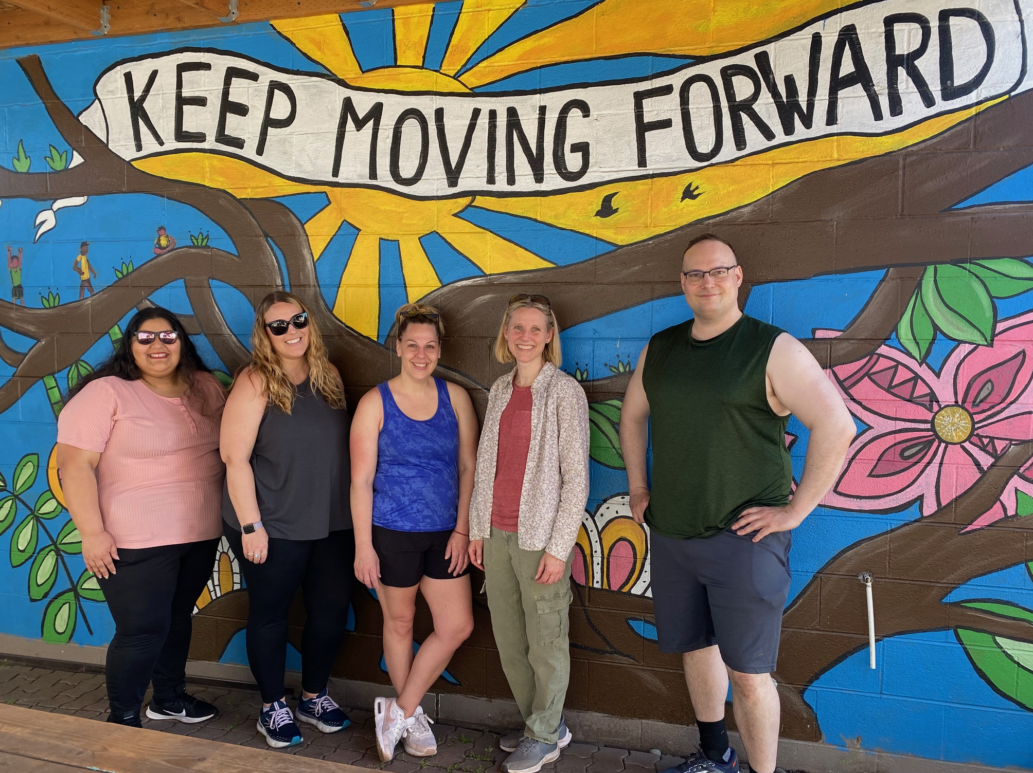
Overquota: People Experiencing Homelessness (PEH)
Priority Population = People Experiencing Homelessness (PEH)
Respondents:
96 PEH
+ 478 Housed
574 Total
17% of respondents are PEH
Show break-outs, not aggregate

Slide 5
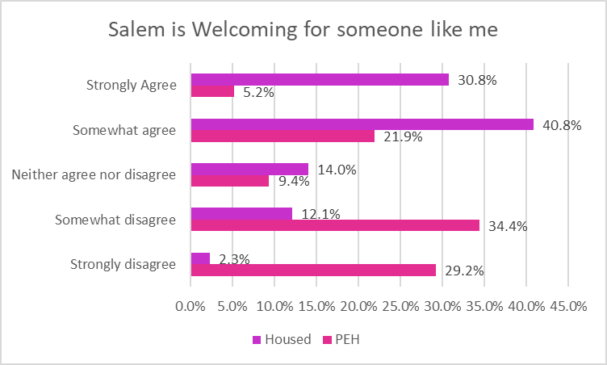
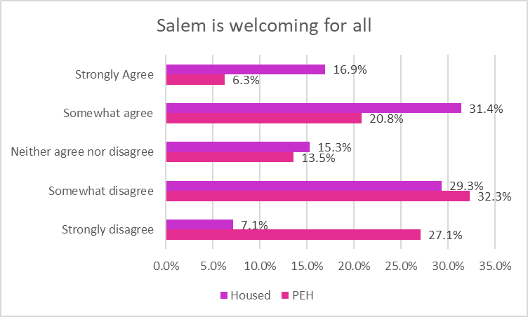
Perceptions of Salem as a Welcoming Community
Salem is generally perceived to be a welcoming community by Housed respondents, but not by People Experiencing Homelessness (PEH).
Housed: 72% either strongly agree or somewhat agree
PEH: 27% either strongly agree or somewhat agree

Slide 6
Rating for Level of Discrimination
Overall, how would you rate the level of discrimination in Salem, Oregon?
Excellent: almost no discrimination
Good: small amount of discrimination
Average: medium amount of discrimination
Poor: quite a bit of discrimination
Failing: a lot of discrimination

Slide 7
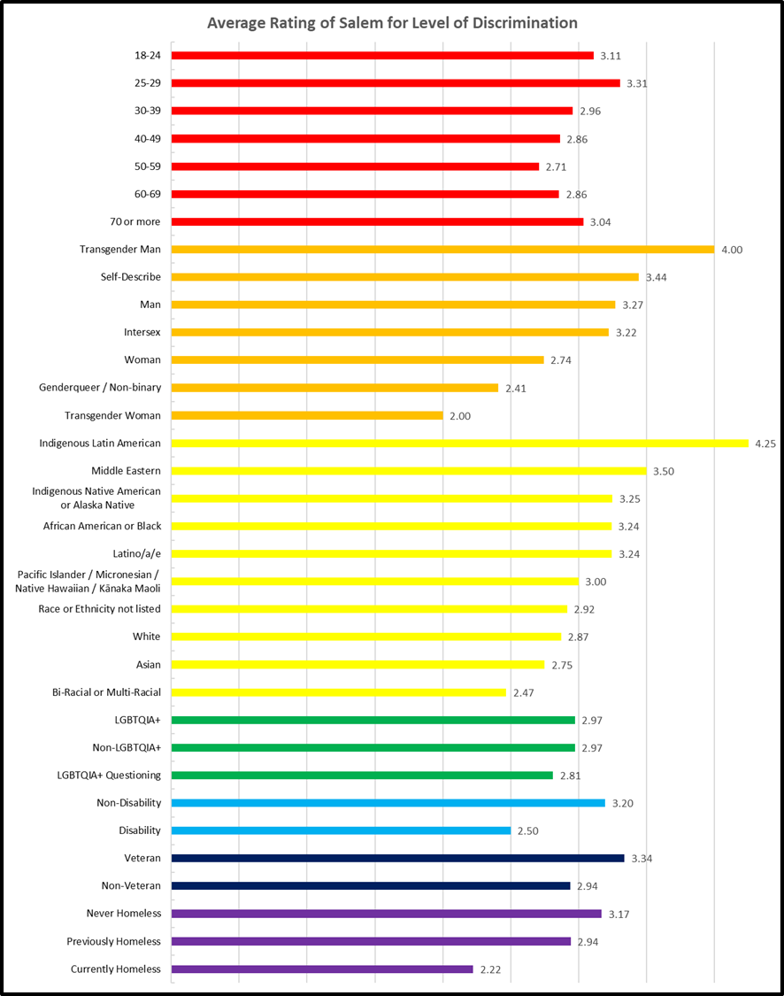
Rating for Level of Discrimination
(Where Excellent = 5, Very Good = 4, Average = 3, Poor = 2, Failing = 1)
Average rating among Housed: 3.11
Average rating among PEH: 2.23
Sub-groups with low average rating:
PEH, women, genderqueer/non-binary, trans women, bi-racial or multi-racial, and people with a disability.

Slide 8
Example Comments: Positive Rating
Salem is much better than the city I moved from in the Midwest. I don’t think that Salem is perfect, but I also feel that the city leaders are trying the best they can to make the city better.
My sense is that most people here are welcoming and inclusive, but we still have a long ways to go.
I have not felt discrimination directed towards myself.

Slide 9
Example Comments: Negative Rating
The discrimination I see is mainly regarding people experiencing homelessness. People make assumptions about them without really understanding the situation they are in.
There is a strong racist and white supremacist core in Salem that is especially evident in efforts to erase the identity of students of color and LGBTQ+ kids in public schools. Book banning, removing history of racism, and demonizing trans kids is evidence.
I see discrimination all the time, people are mean, and they don’t care who they lash out at.

Slide 10
Discrimination: Heard About/ Witnessed
 | Heard About / Observed Discrimination: % Yes | Frequency: % Daily + % Weekly | Top 3 Types of Discrimination Observed / Heard About (Mark all)
Housed | 65% | 20% | 68% Race/Color/National Origin 53% Housing Status 40% Language Spoken 40% Gender Identity 40% Sexual Orientation
PEH | 90% | 57% | 87% Housing Status 47% Race/Color/National Origin 41% Mental Disability
Notes:
More than half of respondents have heard about or witnessed discrimination in Salem in the past 12 months. Those who said “yes” were asked how frequently and what types of discrimination they heard about or witnessed.

Slide 11
Discrimination: Experienced
 | Personally Experienced Discrimination: % Yes | Frequency: % Daily + % Weekly | Top 3 Types of Discrimination Personally Experienced (Mark all)
Housed | 33% | 23% | 41% Race/Color/National Origin 29% Weight or Body Type 25% Gender
PEH | 89% | 76% | 86% Housing Status 27% Race/Color/National Origin 15% Mental Disability
Notes:
About 1 in 3 of housed respondents have personally experienced discrimination in Salem in the past 12 months. But among PEH, almost all respondents have personally experienced discrimination here. Again, those who indicated “yes” were asked how frequently and what types of discrimination they have experienced.

Slide 12
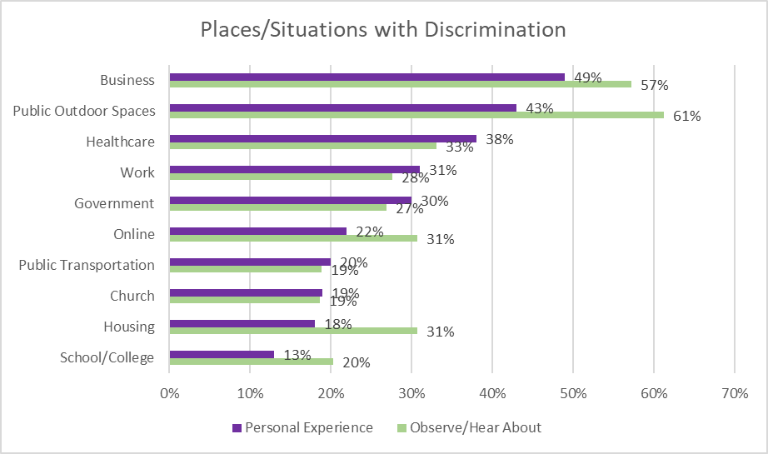
Places/Situations
Most common places/situations with discrimination:
Businesses
Public Outdoor Spaces
Healthcare settings

Slide 13
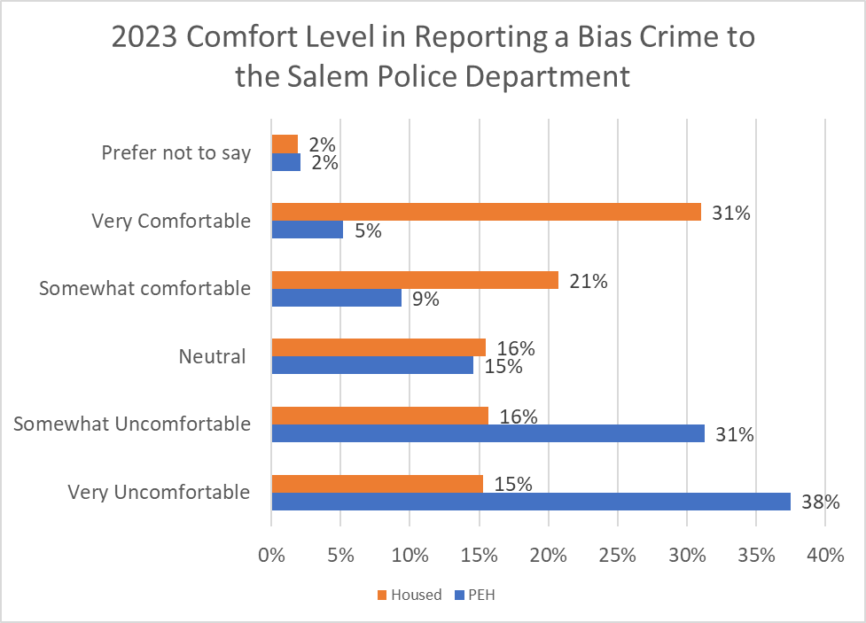
Comfort Level for Reporting a Bias Crime to SPD
Housed: 52% comfortable
PEH: 69% uncomfortable
Notes:
The majority of housed respondents indicated they would be comfortable reporting a biased crime to the Salem Police Department, while the majority of people experiencing homelessness (PEH), indicated they would be uncomfortable doing so.

Slide 14
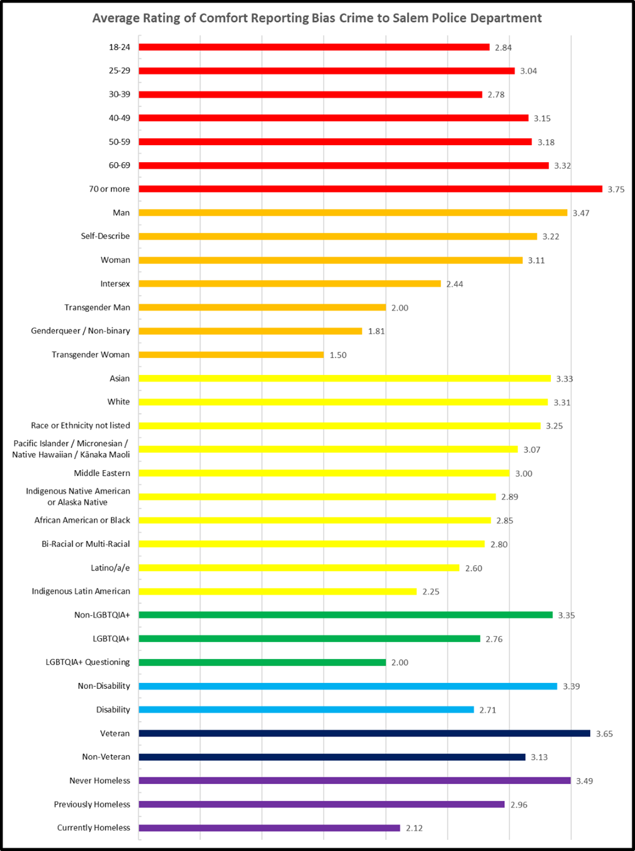
Comfort Level for Reporting a Bias Crime to SPD
Sub-groups with low average comfort levels:
PEH, intersex, genderqueer/non-binary, trans men, trans women, Indigenous Latin American, Latino/a/e, and younger respondents (39 and younger).
Notes:
This rainbow table compares the comfort level of reporting a bias crime among sub-groups. Across all sub-groups, those with the lowest score for comfort are gender identities: Intersex, trans man, gender queer/non-binary, trans woman, and questioning LGBTQIA+.

Slide 15
Example Comments: Comfortable
I have had limited interaction with Salem Police, and Marion County Sheriff and I found them to be professional, willing to listen and explain things, and interested in the local community. I have attended neighborhood meetings where Sheriffs attend.
I am white and middle class and know that based on the privilege this affords me I would be comfortable reporting any crime
A crime is a crime, that’s what the police are here for.

Slide 16
Example Comments: Uncomfortable
I would not trust the Salem Police to take it seriously or follow-up. In addition, I would be concerned about being doubted or further victimized.
The Salem Police Department is a big part of the problem and is discriminatory and dismissive of issues pertaining to those in marginalized groups. They commit violence against BIPOC individuals in Salem and do not help me feel safe or protected.
I feel like I will be deported or that somehow, I will end up with a charge against me.

Slide 17
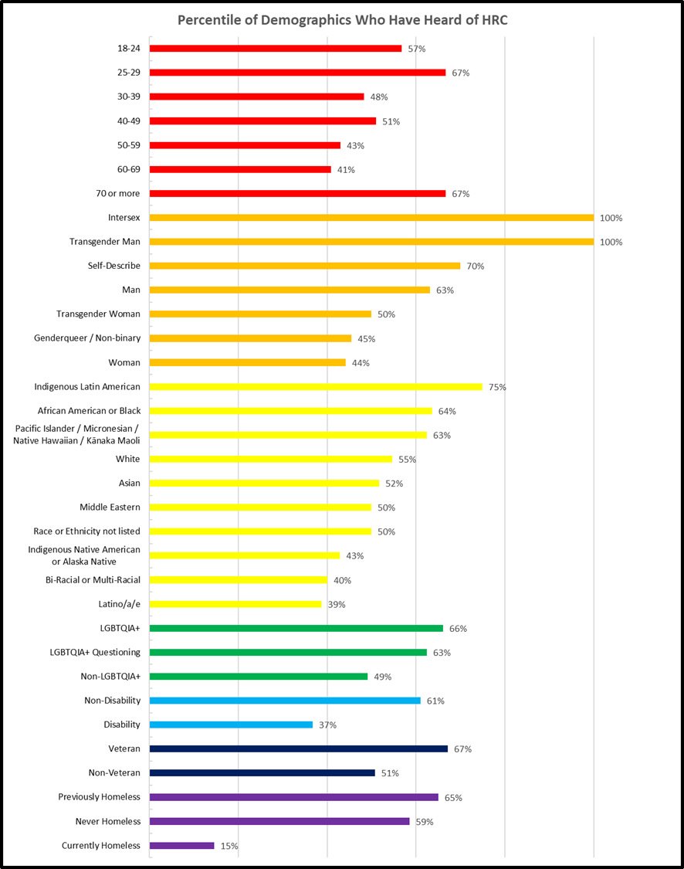
Awareness of HRC
% Aware of HRC among respondents who received the survey from the City of Salem (Facebook/Instagram page or email list):
51% 2020
62% 2021
43% 2022
69% 2023
2023 Awareness:
Housed: 60% aware of HRC
PEH: 15% aware of HRC

Slide 18
Recommendations for Future Surveys
Make survey available in languages in addition to English and Spanish
Add “service provider/non-profit agency” as an answer option to places/situations question
Develop distribution plan for priority populations besides PEH

Slide 19
Recommendations for HRC
Communicate findings from survey
Develop an action plan to increase awareness of HRC among PEH
Work with local healthcare partners to decrease discrimination in healthcare settings
Partner with Salem Police Department to improve relationships and community trust

Slide 20
Conclusion
Questions?
Thank you!

