Slide 1
Capital Improvement Program (CIP) Policy Update
Finance Committee
February 20, 2024

Slide 2
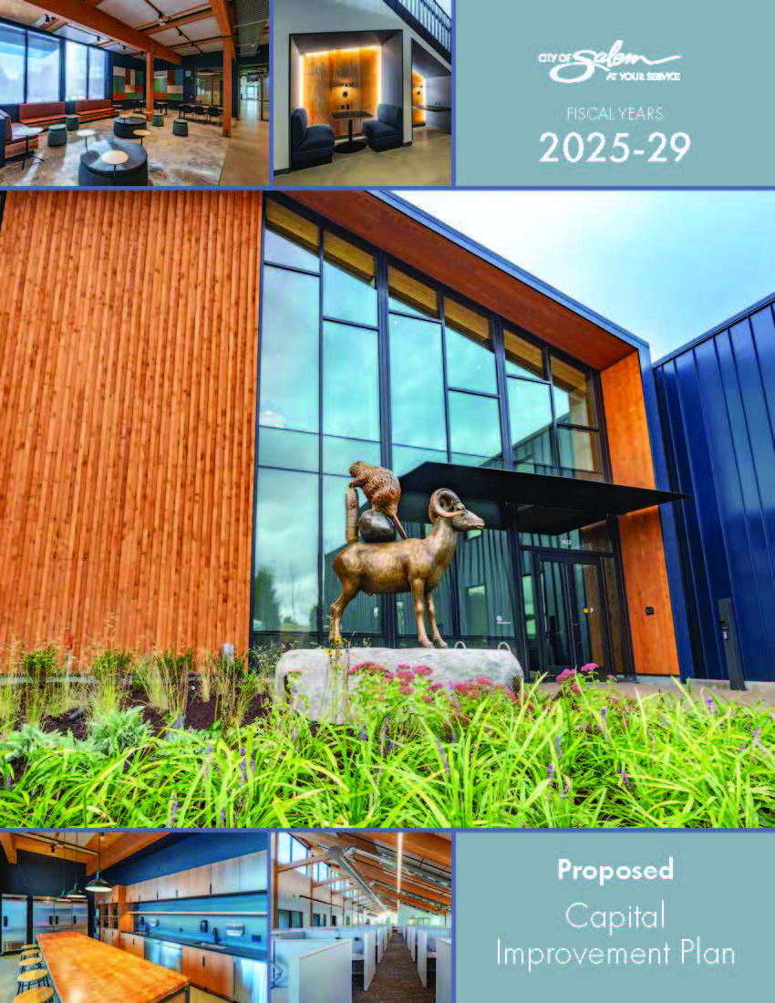
What is a CIP?
Five-year financial planning tool
Multi-year timeframe
Governed by Council policy C-9 and ORS 223.309
Notes:
A capital improvement plan (or CIP) is a five-year plan for capital spending. Like a budget, the CIP matches expected revenues with planned expenditures. But unlike a budget, the CIP has a multi-year time line, which is helpful when planning large expenditures for projects that may span multiple years.
Preparation of the CIP is governed by Council Policy C-9. In addition, ORS chapter 223 requires that projects financed by system development charges be part of an adopted financial plan. The CIP can be used to fulfill this requirement.

Slide 3
CIP Policy Background
Council Policy was last updated in 2008.
Before that, the CIP process was guided by Department Head Letter #7, adopted in 1992.
The Agenda packet contains three versions of the document in this order:
Existing Council Policy C-9
‘Redline’ version of proposed Council Policy C-9 with updates
‘Clean’ version of Council Policy C-9 with updates

Slide 4
Updates
Increase CIP project threshold from $50,000 to $100,000
General US inflation (CPI) since 2008 increased by roughly 45%
Routine maintenance projects are qualifying as CIP projects
Reduces administrative staff time to manage
Notes:
Since policy adoption in 2008, general US inflation (CPI) has increased by roughly 45%.
Projects that have historically been categorized as “routine maintenance” are more frequently qualifying as CIP projects.
CIP project status requires more administrative staff time to manage, further inflating project costs.

Slide 5
Updates
Clarify the role of the CIP Staff Review Committee
review project proposals
analyze organizational capacity and funding
score projects
develop the proposed CIP with staff recommendations.
Designate Finance Committee as City Council Liaison on CIP matters
CIP draft review
project guidance
progress updates
Notes:
Specifies that the Staff Committee’s role is to review project proposals, analyze organizational capacity and funding to complete projects, score projects, and develop the proposed CIP with staff recommendations.
Designation of the Finance Committee as the City Council liaison for CIP matters including CIP draft review, project guidance, and progress updates.

Slide 6
Updates
Add public outreach component to engage with various stakeholders
Clarify that all CIP mid-year project additions be forwarded to City Council for approval
Mid-year project additions over $100,000 be forwarded to City Council for approval
Notes:
Directs staff to implement an outreach program to include engagement with various stakeholders through multiple platforms.
Clarifies that all new, mid-year project additions estimated at over $100,000 be forwarded to City Council for approval.

Slide 7
Recommendation:
Finance Committee review the updated Council Policy C-9, Capital Improvement Program and recommend to City Council for adoption.

