Slide 1
What does the future hold for you?
Tax-deferred plans: 457(b)
Wendy E. Stefani, CFS
Financial Adviser
October 2021
CN1731304_0723
Notes:
Welcome to today’s presentation entitled “What Does the Future Hold for You? Taxed-Deferred Plans: 457(b).” This presentation contains information regarding insurance products for sale.

Slide 2
Important Information
Not FDIC/NCUA/NCUSIF Insured I Not a Deposit of a Bank/Credit Union I May Lose Value I Not Bank/Credit Union Guaranteed I Not Insured by Any Federal Government Agency
Any insurance products, annuities and funding agreements that you may have purchased are sold as securities and are issued by Voya Retirement Insurance and Annuity Company ("VRIAC"), Windsor, CT or ReliaStar Life Insurance Company, ("ReliaStar"), Minneapolis, MN. VRIAC or ReliaStar is solely responsible for meeting its obligations. Plan administrative services provided by VRIAC or Voya Institutional Plan Services, LLC (“VIPS”). Neither VRIAC nor VIPS engage in the sale or solicitation of securities. If custodial or trust agreements are part of this arrangement, they may be provided by Voya Institutional Trust Company. All companies are members of the Voya ® family of companies.
Securities distributed by Voya Financial Partners, LLC (member SIPC) or other broker-dealers with which it has a selling agreement.
All products or services may not be available in all states.
Notes:
Retirement Advisory Distribution and Tax Sheltered Annuity representatives, keep
this slide.
Legacy VFA representatives, hide this slide.

Slide 3
Important Information
Variable annuities are long-term investments designed for retirement purposes. Early withdrawals prior to age 59½ may be subject to a 10% premature distribution penalty tax, unless an exception applies. Money taken from the annuity will be taxed as ordinary income in the year the money is distributed. Account values fluctuate with market conditions, and when surrendered the principal may be worth more or less than its original amount invested. An annuity does not provide any additional tax deferral benefit, as tax deferral is provided by the plan. Annuities may be subject to additional fees and expenses to which other tax-qualified funding vehicles may not be subject. However, an annuity does provide other features and benefits, such as lifetime income payments and death benefits, which may be valuable to you.
Variable investments, of any kind, are not guaranteed and are subject to investment risk including the possible loss of principal. The investment return and principal value of the security will fluctuate so that when redeemed, it may be worth more of less than the original investment. In addition, there is no guarantee that any variable investment option will meet its stated objective.
All guarantees are based on the financial strength and claims-paying ability of the issuing insurance company, who is solely responsible for all obligations under its policies.
Notes:
Keep this slide if presenting to the following, otherwise, hide slide.
Retail VA market (individual variable annuities)
Tax Exempt Market (group healthcare, government, education)
TSA Market (individual tax deferred annuity)
Corporate Market

Slide 4
Sources of retirement income for today’s retirees
NEW
Will Social Security cover your retirement income needs? Probably not.
On average, retirees receive only 40% of their pre-retirement income from SS.
The average SS retirement benefit was only about $1,514 a month, or $18,170 a year.¹
Where will the rest of your retirement income come from?
It likely will come from a variety of sources depending on your personal circumstances and employment history. Sources might include:
Social Security retirement benefits
Defined benefit pension plan
Defined contribution plan (e.g., 457(b), 403(b))
IRA or other investments
Health Savings Accounts (HSA)
Personal savings
Part-time employment
¹ As of June 2020, Social Security Administration - Learn About Retirement Benefits https://www.ssa.gov/benefits/retirement/learn.html
Notes:
Many people assume that Social Security will cover their retirement income needs. That’s not the case for most people.
If you have paid into Social Security throughout your employment you will receive a benefit in retirement…but it may not be as much as you anticipated.
Maybe you’re one of the fortunate few who may work – or have worked – for an employer who offers a pension plan. Even if you will eventually receive pension payments from an employer, chances are pension payments will constitute only a small percentage of your total retirement income.
That leaves you responsible a large portion of your retirement income! It’s likely your income will come from a variety of sources. Unless you want to work forever, you need to start planning on where the money is going to come from… or start thinking about which of those future dreams you may need to put on hold. The earlier you start planning, the better chance you have to reach your goals.

Slide 5
Sources of retirement income for today’s retirees
NEW
Most retirees won’t receive income from Social Security and a defined benefit pension plan and a defined contribution plan.
You need to plan for how you will supplement your retirement income.
Retirement Income Sources for Retirees Age 60+
Examining the Nest Egg: the Sources of Retirement Income for Older Americans, National Institute on Retirement Security, January 2020
Notes:
A report released in 2020 by the National Institute of Retirement Security focused on the traditional sources of retirement income - often called the three-legged stool (SS, pension and defined contribution).
The outcome of the report may surprise you. For example, only about 6.8% of retirees receive income from all 3 traditional sources. And 40% rely only on Social Security for their retirement income which for most people cannot adequately replace their pre-retirement income.
Reports like this reinforce the notion that early planning—combined with saving and investing—may be the best approach to help meet your retirement goals.

Slide 6
Your expenses don’t end when you retire
How long do you expect to live in retirement… the next 1/3 of your life?
65-year old female: 65% chance of living past age
85
65-year old male: 55% chance of living past age
85
Employer’s Checks
Your Age | 25 | 35 | 45 | 55 | 65 | 75 | 85 | 95
Funding for your future goals
The truth is, you may need to live without a paycheck, as long as you have lived with one. How much will you need?
Source: Society of Actuaries, Longevity Illustrator 2019
https://www.soa.org/research/tables-calcs-tools/
Notes:
How long were you expecting to be retired? Here are some eye-opening projections from the National Center for Health Statistics:
• today’s 65-year-old male has a 50 percent chance of living until age 81
• today’s 65-year-old female has a 50 percent chance of living until age 84
So, even though it’s tricky to estimate exactly how long you’ll live, the fact is, most people underestimate how long they’ll be around, and how much they’ll need to sustain themselves all those years.

Slide 7
Effects of inflation
$50,000
$43,130
$37,205
$32,093
$27,684
Assumptions: $30,000 annual salary and 3% rate of inflation.
Notes:
This chart is an example on the effects of inflation on an salary of $50,000. In five years, assuming a 3% inflation rate, that $50,000 annual salary may not be sufficient in order for you to maintain your current lifestyle. In about 20 years, inflation alone may erode your purchasing power to the point where your salary translates to a little more than half of the amount you earn today.
Depending on your current lifestyle, goals and dreams, you’ll need to determine how much money may be needed to accomplish your long-term objectives. Social Security and personal savings alone might not be enough. It’s very possible that the effects of inflation could strongly impact Social Security and personal savings thereby creating the need to save for retirement through an employer-sponsored retirement plan.

Slide 8
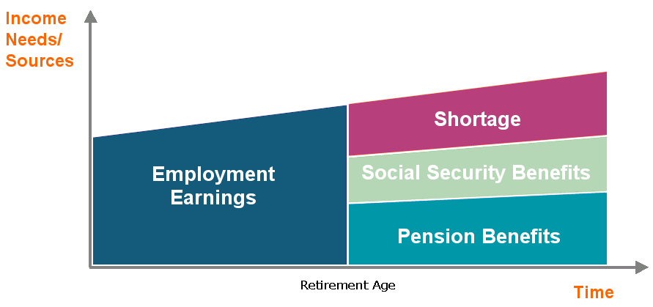
Will you have enough to fund your retirement?
With Educators’ Financial Analysis, you and your financial professional can run a report on your financial status in just 15 minutes!
IMPORTANT: The illustrations or other information generated regarding the likelihood of various investment outcomes are hypothetical in nature, do not reflect actual investment results and are not guarantees of future results.
Notes:
These next 3 slides are for use when the client WORKS IN THE EDUCATION MARKET ONLY and has both retirement system benefits and Social Security benefits.
Voya has a tool called Educators’ Financial Analysis which generates hypothetical illustrations based on your current financial status, including current paychecks/investments/assets/debts to provide you with a snapshot of possible income needs over an extended period of time.
You can get a personalized analysis of your financial strategy and the data you need to possibly make some adjustments to that strategy.
Best part? It’s FREE -- there’s no cost or obligation -- and takes only about 15 minutes to go through with your financial professional!

Slide 9
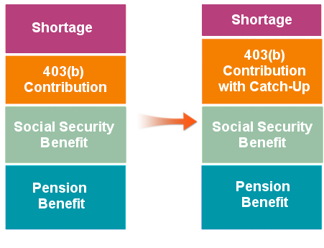
Catch-up contributions can help make up for lost time
If you are over age 50...
You can contribute an additional $6,500 above the 2021 annual limit of $19,500. The limit is subject to annual cost of living adjustments.
Income Needs and Sources
457(b)
457(b)
Catch-up contributions can help reduce your retirement income shortage.
Notes:
This slide is for use when the Education client has a 457(b), retirement system benefits and Social Security benefits.

Slide 10
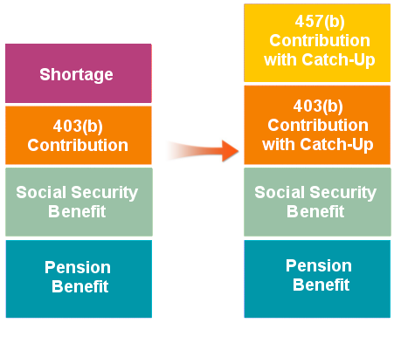
Additional savings opportunities with 403(b) plans
Consider both plans...
Income Needs and Sources
Participate in both a 403(b) and a 457(b) and you can contribute the annual maximum (including catch-ups) to both plans.
Generally, the 10% Internal Revenue Code (IRC) premature distribution penalty tax on early withdrawals doesn’t apply to 457(b). This means that if you need to take a distribution before you reach age 59½, consider taking the distribution from your 457(b) plan, provided you have a triggering event.
See your Summary Plan Document or contact your Human Resource Department for more information about the plans.
403(b)
457(b)
457(b)
Contributions to both a 457(b) and a 403(b) can help further reduce your retirement income shortage.
Notes:
This slide is for use when the Education client has both a 457(b) and a 403(b), retirement system benefits and Social Security benefits.

Slide 11
Additional savings opportunities with 403(b) plans…cont’d
For 403(b)(1) fixed or variable annuities, employee deferrals (including earnings) may generally be distributed only upon your: attainment of age 59½, severance from employment, death, disability, or hardship. Note: Hardship withdrawals are limited to employee deferrals made after 12/31/88. Exceptions to the distribution rules: No Internal Revenue Code withdrawal restrictions apply to '88 cash value (employee deferrals (including earnings) as of 12/31/88) and employer contributions (including earnings). However, employer contributions made to an annuity contract issued after December 31, 2008 may not be paid or made available before a distributable event occurs. Such amounts may be distributed to a participant or if applicable, the beneficiary: upon the participant's severance from employment or upon the occurrence of an event, such as after a fixed number of years, the attainment of a stated age, or disability.
Notes:
Disclosure for previous slide must be shown to audience per compliance.

Slide 12
Will you have enough to fund your retirement?
With Voya Financial Analysis, you and your financial professional can run a report on your financial status in just 15 minutes!
IMPORTANT: The illustrations or other information generated regarding the likelihood of various investment outcomes are hypothetical in nature, do not reflect actual investment results and are not guarantees of future results.
Notes:
These next 3 slides are for use when the client WORKS IN A NON-EDUCATION INDUSTRY and has both retirement system benefits and Social Security benefits.
Voya has a tool called Voya Financial Analysis which generates hypothetical illustrations based on your current financial status, including current paychecks/investments/assets/debts to provide you with a snapshot of possible income needs over an extended period of time.
You can get a personalized analysis of your financial strategy and the data you need to possibly make some adjustments to that strategy.
Best part? It’s FREE -- there’s no cost or obligation -- and takes only about 15 minutes to go through with your financial professional!

Slide 13
Additional savings opportunities with 403(b) plans
Consider both plans...
Income Needs and Sources
Participate in both a 403(b) and a 457(b) and you can contribute the annual maximum (including catch-ups) to both plans.
Generally, the 10% Internal Revenue Code (IRC) premature distribution penalty tax on early withdrawals doesn’t apply to 457(b). This means that if you need to take a distribution before you reach age 59½, consider taking the distribution from your 457(b) plan, provided you have a triggering event.
See your Summary Plan Document or contact your Human Resource Department for more information about the plans.
403(b)
457(b)
457(b)
Contributions to both a 457(b) and a 403(b) can help further reduce your retirement income shortage.
Notes:
This slide is for use when the Non-Education client has both a 457(b) and a 403(b).

Slide 14
Additional savings opportunities with 403(b) plans…cont’d
For 403(b)(1) fixed or variable annuities, employee deferrals (including earnings) may generally be distributed only upon your: attainment of age 59½, severance from employment, death, disability, or hardship. Note: Hardship withdrawals are limited to employee deferrals made after 12/31/88. Exceptions to the distribution rules: No Internal Revenue Code withdrawal restrictions apply to '88 cash value (employee deferrals (including earnings) as of 12/31/88) and employer contributions (including earnings). However, employer contributions made to an annuity contract issued after December 31, 2008 may not be paid or made available before a distributable event occurs. Such amounts may be distributed to a participant or if applicable, the beneficiary: upon the participant's severance from employment or upon the occurrence of an event, such as after a fixed number of years, the attainment of a stated age, or disability.
Notes:
Disclosure for previous slide must be shown to audience per compliance.

Slide 15
Catch-up contributions can help make up for lost time
If you are over age 50...
You can contribute an additional $6,500 above the 2021 annual limit of $19,500. The limit is subject to annual cost of living adjustments.
Income Needs and Sources
457(b)
457(b)
Notes:
This slide is for use when the Non-Education client has both a 457(b) and a 403(b), retirement system benefits and Social Security benefits.

Slide 16
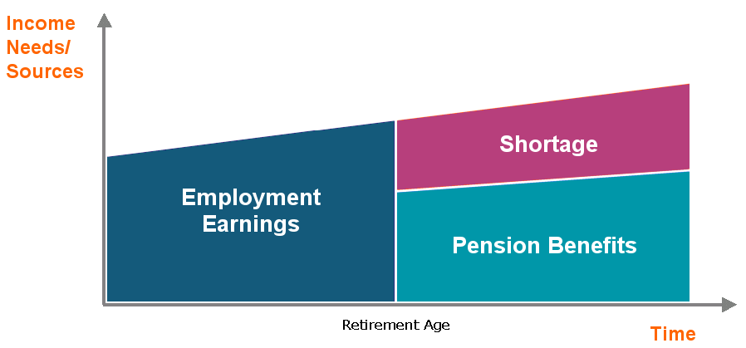
Will you have enough to fund your retirement?
With Educators’ Financial Analysis, you and your financial professional can run a report on your financial status in just 15 minutes!
IMPORTANT: The illustrations or other information generated regarding the likelihood of various investment outcomes are hypothetical in nature, do not reflect actual investment results and are not guarantees of future results.
Notes:
These next 3 slides are for use when the client WORKS IN THE EDUCATION MARKET ONLY (public schools) and has retirement system benefits but NO Social Security benefits.
Voya has a tool called Educators’ Financial Analysis which generates hypothetical illustrations based on your current financial status, including current paychecks/investments/assets/debts to provide you with a snapshot of possible income needs over an extended period of time.
You can get a personalized analysis of your financial strategy and the data you need to possibly make some adjustments to that strategy.
Best part? It’s FREE -- there’s no cost or obligation -- and takes only about 15 minutes to go through with your financial professional!

Slide 17
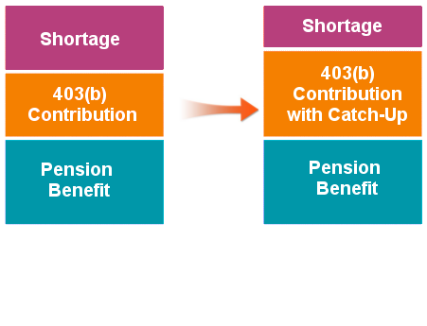
Catch-up contributions can help make up for lost time
If you are over age 50...
Income Needs and Sources
You can contribute an additional $6,500 above the 2021 annual limit of $19,500. The limit is subject to annual cost of living adjustments.
457(b)
457(b)
Notes:
This slide is for use when the Education client has a 403(b), retirement system benefits, and NO Social Security benefits.

Slide 18
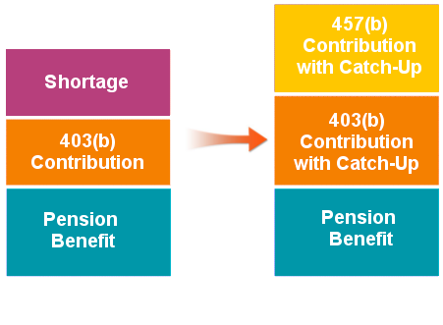
Additional savings opportunities with 457(b) plans
Consider both plans...
Participate in both a 403(b) and a 457(b) and you can contribute the annual maximum (including catch-ups) to both plans.
Generally, the 10% Internal Revenue Code (IRC) premature distribution penalty tax on early withdrawals doesn’t apply to 457(b). This means that if you need to take a distribution before you reach age 59½, consider taking the distribution from your 457(b) plan, provided you have a triggering event.
See your Summary Plan Document or contact your Human Resource Department for more information about the plans.
Income Needs and Sources
403(b)
457(b)
457(b)
Contributions to both a 403(b) and a 457(b) can help further reduce your retirement income shortage.
Notes:
This slide is for use when the Education client has both a 403(b) and a 457(b), retirement system benefits and NO Social Security benefits.

Slide 19
Additional savings opportunities with 457(b) plans…cont’d
For 403(b)(1) fixed or variable annuities, employee deferrals (including earnings) may generally be distributed only upon your: attainment of age 59½, severance from employment, death, disability, or hardship. Note: Hardship withdrawals are limited to employee deferrals made after 12/31/88. Exceptions to the distribution rules: No Internal Revenue Code withdrawal restrictions apply to '88 cash value (employee deferrals (including earnings) as of 12/31/88) and employer contributions (including earnings). However, employer contributions made to an annuity contract issued after December 31, 2008 may not be paid or made available before a distributable event occurs. Such amounts may be distributed to a participant or if applicable, the beneficiary: upon the participant's severance from employment or upon the occurrence of an event, such as after a fixed number of years, the attainment of a stated age, or disability.
Notes:
Disclosure for previous slide must be shown to audience per compliance.

Slide 20
Will you have enough to fund your retirement?
With Voya Financial Analysis, you and your financial professional can run a report on your financial status in just 15 minutes!
IMPORTANT: The illustrations or other information generated regarding the likelihood of various investment outcomes are hypothetical in nature, do not reflect actual investment results and are not guarantees of future results.
Notes:
These next 2 slides are for use when the client WORKS IN A NON-EDUCATION INDUSTRY and has retirement system benefits but NO Social Security benefits.
Voya has a tool called Voya Financial Analysis which generates hypothetical illustrations based on your current financial status, including current paychecks/investments/assets/debts to provide you with a snapshot of possible income needs over an extended period of time.
You can get a personalized analysis of your financial strategy and the data you need to possibly make some adjustments to that strategy.
Best part? It’s FREE -- there’s no cost or obligation -- and takes only about 15 minutes to go through with your financial professional!

Slide 21
Additional savings opportunities with 403(b) plans
Consider both plans...
Income Needs and Sources
Participate in both a 403(b) and a 457(b) and you can contribute the annual maximum (including catch-ups) to both plans.
Generally, the 10% Internal Revenue Code (IRC) premature distribution penalty tax on early withdrawals doesn’t apply to 457(b). This means that if you need to take a distribution before you reach age 59½, consider taking the distribution from your 457(b) plan, provided you have a triggering event.
See your Summary Plan Document or contact your Human Resource Department for more information about the plans.
403(b)
457(b)
457(b)
Contributions to both a 403(b) and a 457(b) can help further reduce your retirement income shortage.
Notes:
This slide is for use when the Non-Education client has both a 403(b) and a 457(b), retirement system benefits but NO Social Security benefits.

Slide 22
Additional savings opportunities with 403(b) plans…cont’d
For 403(b)(1) fixed or variable annuities, employee deferrals (including earnings) may generally be distributed only upon your: attainment of age 59½, severance from employment, death, disability, or hardship. Note: Hardship withdrawals are limited to employee deferrals made after 12/31/88. Exceptions to the distribution rules: No Internal Revenue Code withdrawal restrictions apply to '88 cash value (employee deferrals (including earnings) as of 12/31/88) and employer contributions (including earnings). However, employer contributions made to an annuity contract issued after December 31, 2008 may not be paid or made available before a distributable event occurs. Such amounts may be distributed to a participant or if applicable, the beneficiary: upon the participant's severance from employment or upon the occurrence of an event, such as after a fixed number of years, the attainment of a stated age, or disability.
Notes:
Disclosure for previous slide must be shown to audience per compliance.

Slide 23
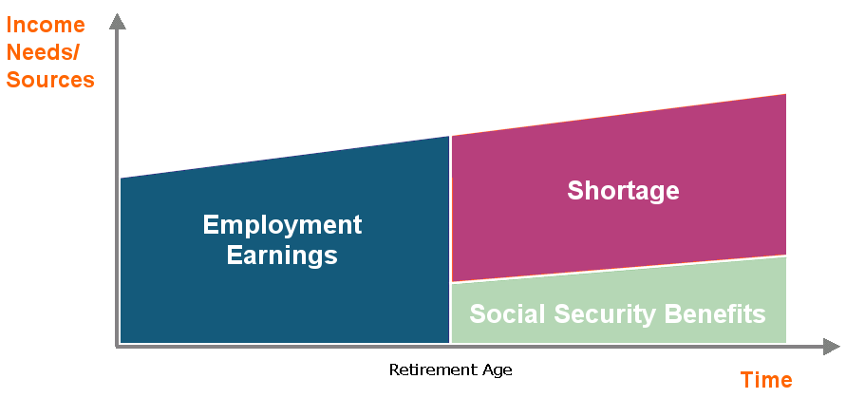
Will you have enough to fund your retirement?
With Educators’ Financial Analysis, you and your financial professional can run a report on your financial status in just 15 minutes!
IMPORTANT: The illustrations or other information generated regarding the likelihood of various investment outcomes are hypothetical in nature, do not reflect actual investment results and are not guarantees of future results.
Notes:
These next 3 slides are for use when the client WORKS IN THE EDUCATION MARKET ONLY and has NO retirement system benefits but has Social Security benefits.
Voya has a tool called Educators Financial Analysis which generates hypothetical illustrations based on your current financial status, including current paychecks/investments/assets/debts to provide you with a snapshot of possible income needs over an extended period of time.
You can get a personalized analysis of your financial strategy and the data you need to possibly make some adjustments to that strategy.
Best part? It’s FREE -- there’s no cost or obligation -- and takes only about 15 minutes to go through with your financial professional!

Slide 24
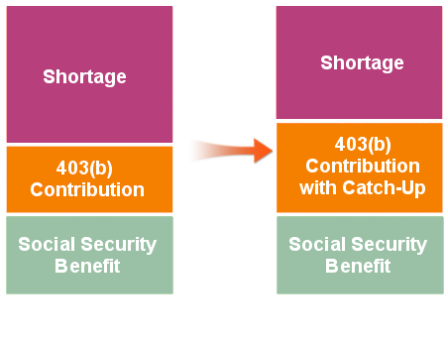
Catch-up contributions can help make up for lost time
If you are over age 50...
You can contribute an additional $6,500 above the 2021 annual limit of $19,500. The limit is subject to annual cost of living adjustments.
Income Needs and Sources
If you have 15 years of service...
457(b)
Additional catch-up contributions are available to certain employees who have 15 years of service or more.
457(b)
Catch-up contributions can help reduce your retirement income shortage.
Notes:
This slide is for use when the Education client has a 403(b) only, NO retirement system benefits but has Social Security benefits.

Slide 25
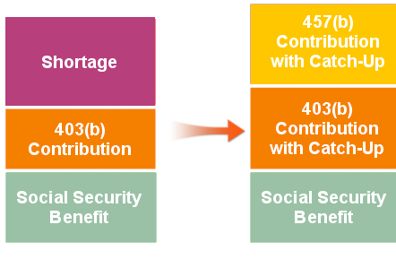
Additional savings opportunities with 403(b) plans
Consider both plans...
Income Needs and Sources
Participate in both a 403(b) and a 457(b) and you can contribute the annual maximum (including catch-ups) to both plans.
Generally, the 10% Internal Revenue Code (IRC) premature distribution penalty tax on early withdrawals doesn’t apply to 457(b). This means that if you need to take a distribution before you reach age 59½, consider taking the distribution from your 457(b) plan, provided you have a triggering event.
See your Summary Plan Document or contact your Human Resource Department for more information about the plans.
403(b)
457(b)
457(b)
Contributions to both a 403(b) and a 457(b) can help further reduce your retirement income shortage.
Notes:
This slide is for use when the Education client has both a 403(b) and a 457(b), NO retirement system benefits but has Social Security benefits.

Slide 26
Additional savings opportunities with 403(b) plans…cont’d
For 403(b)(1) fixed or variable annuities, employee deferrals (including earnings) may generally be distributed only upon your: attainment of age 59½, severance from employment, death, disability, or hardship. Note: Hardship withdrawals are limited to employee deferrals made after 12/31/88. Exceptions to the distribution rules: No Internal Revenue Code withdrawal restrictions apply to '88 cash value (employee deferrals (including earnings) as of 12/31/88) and employer contributions (including earnings). However, employer contributions made to an annuity contract issued after December 31, 2008 may not be paid or made available before a distributable event occurs. Such amounts may be distributed to a participant or if applicable, the beneficiary: upon the participant's severance from employment or upon the occurrence of an event, such as after a fixed number of years, the attainment of a stated age, or disability.
Notes:
Disclosure for previous slide must be shown to audience per compliance.

Slide 27
Will you have enough to fund your retirement?
With Voya Financial Analysis, you and your financial professional can run a report on your financial status in just 15 minutes!
IMPORTANT: The illustrations or other information generated regarding the likelihood of various investment outcomes are hypothetical in nature, do not reflect actual investment results and are not guarantees of future results.
Notes:
These next 3 slides are for use when the client WORKS IN A NON-EDUCATION INDUSTRY and has NO retirement system benefits but has Social Security benefits.
Voya has a tool called Voya Financial Analysis which generates hypothetical illustrations based on your current financial status, including current paychecks/investments/assets/debts to provide you with a snapshot of possible income needs over an extended period of time.
You can get a personalized analysis of your financial strategy and the data you need to possibly make some adjustments to that strategy.
Best part? It’s FREE -- there’s no cost or obligation -- and takes only about 15 minutes to go through with your financial professional!

Slide 28
Additional savings opportunities with 403(b) plans
Consider both plans . . .
Income Needs and Sources
Participate in both a 403(b) and a 457(b) and you can contribute the annual maximum (including catch-ups) to both plans.
Generally, the 10% Internal Revenue Code (IRC) premature distribution penalty tax on early withdrawals doesn’t apply to 457(b). This means that if you need to take a distribution before you reach age 59½, consider taking the distribution from your 457(b) plan, provided you have a triggering event.
See your Summary Plan Document or contact your Human Resource Department for more information about the plans.
403(b)
457(b)
457(b)
Contributions to both a 403(b) and a 457(b) can help further reduce your retirement income shortage.
Notes:
This slide is for use when the Non-Education client has both a 403(b) and a 457(b), NO retirement system benefits but has Social Security benefits.

Slide 29
Additional savings opportunities with 403(b) plans…cont’d
For 403(b)(1) fixed or variable annuities, employee deferrals (including earnings) may generally be distributed only upon your: attainment of age 59½, severance from employment, death, disability, or hardship. Note: Hardship withdrawals are limited to employee deferrals made after 12/31/88. Exceptions to the distribution rules: No Internal Revenue Code withdrawal restrictions apply to '88 cash value (employee deferrals (including earnings) as of 12/31/88) and employer contributions (including earnings). However, employer contributions made to an annuity contract issued after December 31, 2008 may not be paid or made available before a distributable event occurs. Such amounts may be distributed to a participant or if applicable, the beneficiary: upon the participant's severance from employment or upon the occurrence of an event, such as after a fixed number of years, the attainment of a stated age, or disability.
Notes:
Disclosure for previous slide must be shown to audience per compliance.

Slide 30
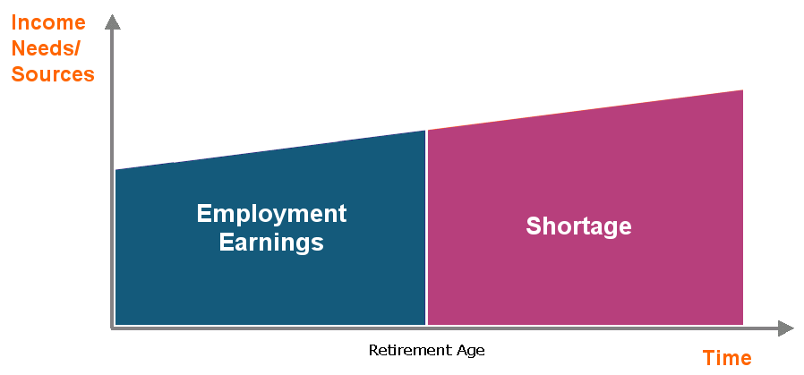
Will you have enough to fund your retirement?
With Educators’ Financial Analysis, you and your financial professional can run a report on your financial status in just 15 minutes!
IMPORTANT: The illustrations or other information generated regarding the likelihood of various investment outcomes are hypothetical in nature, do not reflect actual investment results and are not guarantees of future results.
Notes:
These next 3 slides are for use when the client WORKS IN THE EDUCATION MARKET ONLY and has neither Social Security nor retirement system benefits.
Voya has a tool called Educators Financial Analysis which generates hypothetical illustrations based on your current financial status, including current paychecks/investments/assets/debts to provide you with a snapshot of possible income needs over an extended period of time.
You can get a personalized analysis of your financial strategy and the data you need to possibly make some adjustments to that strategy.
Best part? It’s FREE -- there’s no cost or obligation -- and takes only about 15 minutes to go through with your financial professional!

Slide 31
Catch-up contributions can help make up for lost time
If you are over age 50...
Income Needs and Sources
You can contribute an additional $6,50 above the 2021 annual limit of $19,500. The limit is subject to annual cost of living adjustments.
Shortage
Shortage
If you have 15 years of service...
Additional catch-up contributions are available to certain employees who have 15 years of service or more.
403(b) Contribution
403(b) Contribution
457(b)
457(b)
Catch-up contributions can help reduce your retirement income shortage.
Notes:
This slide is for use when the Education client has a 403(b) only and has neither Social Security nor retirement system benefits.

Slide 32
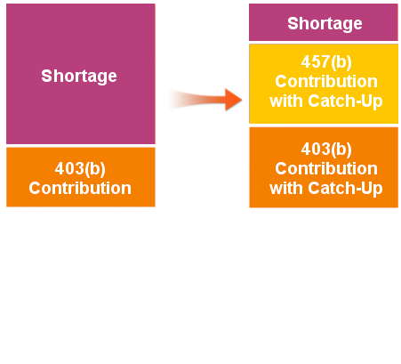
Additional savings opportunities with 403(b) plans
Consider both plans...
Income Needs and Sources
Participate in both a 403(b) and a 457(b) and you can contribute the annual maximum (including catch-ups) to both plans.
Generally, the 10% Internal Revenue Code (IRC) premature distribution penalty tax on early withdrawals doesn’t apply to 457(b). This means that if you need to take a distribution before you reach age 59½, consider taking the distribution from your 457(b) plan, provided you have a triggering event.
See your Summary Plan Document or contact your Human Resource Department for more information about the plans.
403(b)
Shortage
Shortage
457(b)
457(b)
Contributions to both a 403(b) and a 457(b) can help further reduce your retirement income shortage.
Notes:
This slide is for use when the Education client has both a 403(b) and a 457(b), and has neither Social Security nor retirement system benefits.

Slide 33
Additional savings opportunities with 403(b) plans…cont’d
For 403(b)(1) fixed or variable annuities, employee deferrals (including earnings) may generally be distributed only upon your: attainment of age 59½, severance from employment, death, disability, or hardship. Note: Hardship withdrawals are limited to employee deferrals made after 12/31/88. Exceptions to the distribution rules: No Internal Revenue Code withdrawal restrictions apply to '88 cash value (employee deferrals (including earnings) as of 12/31/88) and employer contributions (including earnings). However, employer contributions made to an annuity contract issued after December 31, 2008 may not be paid or made available before a distributable event occurs. Such amounts may be distributed to a participant or if applicable, the beneficiary: upon the participant's severance from employment or upon the occurrence of an event, such as after a fixed number of years, the attainment of a stated age, or disability.
Notes:
Disclosure for previous slide must be shown to audience per compliance.

Slide 34
Will you have enough to fund your retirement?
With Voya Financial Analysis, you and your financial professional can run a report on your financial status in just 15 minutes!
IMPORTANT: The illustrations or other information generated regarding the likelihood of various investment outcomes are hypothetical in nature, do not reflect actual investment results and are not guarantees of future results.
Notes:
These next 3 slides are for use when the client WORKS IN A NON-EDUCATION INDUSTRY and has neither Social Security nor retirement system benefits.
Voya has a tool called Voya Financial Analysis which generates hypothetical illustrations based on your current financial status, including current paychecks/investments/assets/debts to provide you with a snapshot of possible income needs over an extended period of time.
You can get a personalized analysis of your financial strategy and the data you need to possibly make some adjustments to that strategy.
Best part? It’s FREE -- there’s no cost or obligation -- and takes only about 15 minutes to go through with your financial professional!

Slide 35
Additional savings opportunities with 403(b) plans
Consider both plans...
Income Needs and Sources
Participate in both a 403(b) and a 457(b) and you can contribute the annual maximum (including catch-ups) to both plans.
Generally, the 10% Internal Revenue Code (IRC) premature distribution penalty tax on early withdrawals doesn’t apply to 457(b). This means that if you need to take a distribution before you reach age 59½, consider taking the distribution from your 457(b) plan, provided you have a triggering event.
See your Summary Plan Document or contact your Human Resource Department for more information about the plans.
403(b)
Shortage
Shortage
457(b)
457(b)
Contributions to both a 403(b) and a 457(b) can help further reduce your retirement income shortage.
Notes:
This slide is for use when the Non-Education client has both a 403(b) and a 457(b), and has neither Social Security nor retirement system benefits.

Slide 36
Additional savings opportunities with 403(b) plans…cont’d
For 403(b)(1) fixed or variable annuities, employee deferrals (including earnings) may generally be distributed only upon your: attainment of age 59½, severance from employment, death, disability, or hardship. Note: Hardship withdrawals are limited to employee deferrals made after 12/31/88. Exceptions to the distribution rules: No Internal Revenue Code withdrawal restrictions apply to '88 cash value (employee deferrals (including earnings) as of 12/31/88) and employer contributions (including earnings). However, employer contributions made to an annuity contract issued after December 31, 2008 may not be paid or made available before a distributable event occurs. Such amounts may be distributed to a participant or if applicable, the beneficiary: upon the participant's severance from employment or upon the occurrence of an event, such as after a fixed number of years, the attainment of a stated age, or disability.
Notes:
Disclosure for previous slide must be shown to audience per compliance.

Slide 37
The longer you wait, the more it may cost
$48,000
$72,000
Susan started saving $100 a month at age 25. After 40 years, she saved $191,696.
$191,696
Larry started saving $300 a month at age 45. After 20 years, he saved $136,694.
$136,694
Total contributions
Total pre-tax savings at age 65
In this example, Larry ended up contributing 3x’s more per month and a total of $24,000 more than Susan and yet his account ended up $55,002 less than hers.
Hypothetical illustration assumes each tax-deferred account earns a 6.00% annual rate of return (compounded monthly) and a retirement age of 65. Does not reflect the rate of return or incurred costs of any particular investment. Fees and charges would reduce the numbers shown. Does not reflect effect of inflation. Not intended to serve as financial advice or as a primary basis for your investment decisions. Taxes are generally due upon withdrawal. Systematic investment does not ensure a profit nor guarantee against loss. Investors should consider their financial ability to continue their purchases through periods of low price levels.
Notes:
Let’s compare two employees and hypothetically assume their accounts earn the same 6% annual interest rate of return (compounded monthly) on their contributions compounded monthly and they both retire at age 65.
Larry, a high school English teacher starts saving $300 a month in his retirement plan when he’s 45. By age 65, he will have contributed $72,000 from his pay. But because he wisely decided to put it into a tax-deferred plan he ends up with more than $136,694 before fees and taxes. This is possible because he has harnessed the power of ‘compounding.’
Susan, a new teacher in her second year, decided to start saving a $100 at age 25. She thought it was better to start putting away whatever she could. By at age 65, Susan would have contributed $48,000 of her pay to her plan—a little over half of what Larry put aside. But, Susan’s account balance could have grown much larger than what Larry ended up with because she had a longer time to utilize the power of compounding.

Slide 38
Helping more of your money work for you
Out of every $100 you make
You could let the government take $25 in taxes* and save only $75...
Or you could put $100 into a tax-deferred plan.
* Assumes state and federal income taxes of 25%. Distributions from a tax-deferred plan will be taxed as ordinary income when distributed and will be subject to an Internal Revenue Code (IRC) 10% premature distribution penalty tax if taken prior to age 59½, unless an IRS exception applies.
Notes:
Let’s assume your state and federal income taxes total 25%. Out of every $100 you make, you could let the government take around $25 in taxes… leaving you with $75. Or you can contribute $100 to your employer-sponsored 403(b) account.
Normally, the government taxes your earnings – whether those are your salary earnings or your investment earnings. Each year, Uncle Sam takes his cut, leaving you less to build on for the next year.
Not so for a 457(b) plan. Every penny that you contribute and any earnings on amounts in your plan account are tax-deferred until you request a withdrawal or receive a distribution from the plan.

Slide 39
A plan that gives you a tax choice
Traditional 457(b) Option
Roth 457(b) Option
contributions go in pre-tax
earnings are tax deferred
taxes are due upon withdrawal
money goes in after-tax
earnings are tax free
tax-free withdrawals as long as certain qualifying conditions are met*
Combination of Both Options
*Distributions of Roth 457 (b) contributions will be tax-free for federal income tax purposes if they are ‘qualified distributions’ which means the funds are held for a 5 years and the distribution is due to attainment of age 59½, death, or disability.
Notes:
USE SLIDE FOR PLAN WITH TRADITIONAL AND ROTH OPTIONS
DELETE SLIDE FOR PLAN WITH TRADITIONAL OPTION ONLY
Not only does a tax-deferred plan offer key tax advantages, it gives you a choice of when you want to take advantage of the tax-deferral.
You can choose a Traditional 457(b) option—and take advantage of the tax deferral up front.
OR…You can choose a Roth 457(b) option, which takes income tax out of your pay before your contribution is applied to your 457(b) account. Any potential earnings are tax-deferred and you may be able to take advantage of tax-free withdrawals as long as certain qualifying conditions are met. To qualify, Roth contributions must be held at least five years before the date of distribution and you must be 59½ (assuming separation from service, disability, or death).
OR…You can even choose to contribute to both – a portion on a pre-tax basis and some on an after-tax basis

Slide 40
Contribution limits are the same
For 2021, 457(b) contributions are limited by:
The lesser of 100% of includible compensation or
$19,500
But there are other provisions which may help you contribute more to your existing plan...
Notes:
Review Contribution Limits

Slide 41
Special 457(b) catch-up
The 457(b) Special Catch-up Provision* permits increased annual contributions. The catch-up limit is the lesser of:
Twice the annual contribution limit
(for 2021, that would be $39,000) or
The annual contribution limit for the year, plus underutilized amounts from prior taxable years (only those years beginning on or after 1/1/1979 in which you were eligible to participate in your employer’s 457(b) plan can be used).
* A calculation is required to ascertain eligibility.
Notes:
If you’re in the enviable position of being able to contribute the maximum amount as determined by the IRS and can afford to contribute more, your employer’s plan may offer you that opportunity.
Catch-up can only be elected during the three years (consecutive) prior to, but not including, the year the participant attains Normal Retirement Age, as defined by the 457(b) plan. A participant must select only one Normal Retirement Age under all 457(b) plans of that employer.
A calculation is required to determine eligibility. You should consult with an independent tax advisor or financial professional to determine whether you qualify for this catch-up provision.

Slide 42
Age 50+ catch-up
Employees age 50 and older who participate in a governmental 457(b) may be eligible to make additional 457(b) contributions.
For 2021, the potential additional contribution is $6,500*
* Subject to annual cost of living adjustments
NOTE: The age 50+ Catch-up and the Special 457(b) Catch-up cannot be used simultaneously. You must use whichever catch-up lets you defer the greater amount.
Notes:
Employees age 50 and older may be eligible to make additional 457(b) contributions. For 2016, the potential additional contribution is $6,000 and is subject to annual cost of living adjustments in $500 increments. Age is the only eligibility requirement.
The age 50+ Catch-up and the Special 457(b) Catch-up cannot be used simultaneously. You must use whichever catch-up lets you defer the greater amount.

Slide 43
Consider a traditional/pre-tax 457(b) if you...
Enjoy the benefits of current tax deferral
Need to take home as much of your pay as possible
Expect to be in a lower tax bracket in retirement
Seek the advice of a tax attorney or tax advisor prior to making a tax-related insurance/investment decision.
Notes:
USE SLIDE FOR PLAN WITH TRADITIONAL-ONLY OR TRADITONAL & ROTH OPTIONS
Read slide.

Slide 44
Consider a Roth/after-tax 457(b) if you...
Like the idea of possible tax-free retirement income
Are confident of salary increases over time
Can afford a reduction in take-home pay
Seek the advice of a tax attorney or tax advisor prior to making a tax-related insurance/investment decision.
Notes:
USE SLIDE FOR PLAN WITH TRADITIONAL AND ROTH OPTIONS
DELETE SLIDE FOR PLAN WITH TRADITIONAL OPTION ONLY
Read slide.

Slide 45
Consider both if you...
Aren’t sure whether your taxes will be higher or lower when you retire
Want to diversify your tax strategy
Still want to reduce your current taxable income
Seek the advice of a tax attorney or tax advisor prior to making a tax-related insurance/investment decision.
Notes:
USE SLIDE FOR PLAN WITH TRADITIONAL AND ROTH OPTIONS
DELETE SLIDE FOR PLAN WITH TRADITIONAL OPTION ONLY
Read slide.

Slide 46
Crunch the numbers
If you were to contribute to a traditional (pre-tax) 457(b) plan, your monthly numbers could look like this:
Monthly Contribution
Adjusted Gross Income
Disposable Income
Gross Income
Income Taxes*
$3,000
$100
$2,900
$725
$2,175
If you were to contribute to a Roth (after-tax) 457(b) plan, your monthly numbers could look like this:
Monthly Contribution
Disposable
Income
Gross Income
Income Taxes*
Subtotal
$3,000
$750
$2,250
$75
$2,175
* This hypothetical illustration assumes a 25% Federal Income Tax Rate only for a single filer. Any applicable state income taxes would change the results of this illustration. You should always consult with an independent tax advisor or financial professional before making tax or investment related decisions.
Notes:
USE SLIDE FOR PLAN WITH TRADITIONAL AND ROTH OPTIONS
Let’s say you know you want to contribute something to your retirement plan but it’s very important that you have a certain amount of “take home” money.
Based on the assumption that your monthly gross income is $3,000 and you would like at least $2,175 of “disposable income” each month, this chart illustrates the difference in the amount you would contribute to a Traditional 457(b) plan and a Roth 457(b) plan.
This hypothetical illustration assumes a 25% Federal Income Tax Rate only. Any applicable state income taxes would change the results of this illustration. You should always consult with an independent tax advisor or financial professional before making tax or investment related decisions.

Slide 47
Payroll deductions make contributing painless!
Pay yourself first!
Contributions are automatically deducted from your pay.
When you don’t see it, you don’t miss it...
...and you don’t spend it!
Notes:
When you decide to join your employer’s plan, your contributions will be automatically deducted from your paycheck once you’ve completed the enrollment process. There are no long lines to wait in, no errands to try and rush through a lunch hour or on weekends, no hassles!
When your paycheck is issued, your contributions will already have been applied to your account . . . you’ve paid yourself FIRST before you start using your take-home money to pay everyone else!

Slide 48
Rule of thumb
Early stages of work life: 10% of gross income each year if possible.
Later stages of work life: review every two to three years and adjust accordingly.
How much to save and when?
Source: Saving Fitness; A Guide to Your Money and Your Financial Future, U.S. Department of Labor, Employee Benefits Security Administration. September 2019.
Notes:
THIS SLIDE ONLY TO BE USED BY REGISTERED REPRESENTATIVES
So how much will you need to save for the kind of future you’re envisioning?
The answers will always vary and rely on factors such as:
How much do you already have saved?
How long have you been saving?
What is it you want to do when you retire and how much will that cost?
Remember our earlier slide with Susan and Larry? If you’re like Susan and can start saving early in your career, the Department of Labor (DOL) suggests you start saving 10% of your salary.
If your situation is more like Larry and you start to save later on in your career, when you may not be working as many years before you retire, the DOL suggest you review your retirement financial strategy every two to three years and adjust accordingly.

Slide 49
What is a diversified portfolio?
Think of your retirement portfolio as a well-balanced diet.
Notes:
THIS SLIDE ONLY TO BE USED BY REGISTERED REPRESENTATIVES
A well-balanced retirement portfolio is just as important to the “life” of your retirement account as a well-balanced menu is to your life.
Too much of any one thing – whether it’s high-risk funds or too many doughnuts – the end result may not be in your best interest.

Slide 50
Diversify your investment “mix” based on your level of risk
HIGHER
Aggressive
The higher the risk potential, the higher the long-term reward potential
Moderate
Potential Reward
Conservative
The lower the risk potential, the lower the long-term reward potential
LOWER
Potential Risk
Using diversification as part of an investment strategy neither assures nor guarantees better performance and cannot protect against loss in declining markets.
Notes:
THIS SLIDE ONLY TO BE USED BY REGISTERED REPRESENTATIVES.
Now, let’s talk about risk. There are all kinds of investments out there, so how do you choose ones right for you? One consideration is how much risk you’re willing to take.
In short, risk tolerance is all about how willing you are to trade the potential to earn more for the risk of losing some. If you’re the type who’s likely to throw caution to the wind in pursuit of the chance for higher returns, you may want to emphasize stock investments or certain types of bonds.
If you really can’t live with losing any of the money you’ve invested, you may want to stick with lower-risk bonds or cash investments, such as money markets or CDs.
In truth, most folks net out somewhere in between.
Please keep in mind that using diversification as part of an investment strategy neither assures nor guarantees better performance and cannot protect against loss in declining markets.

Slide 51
Diversify your investment “mix” based on asset classes
Global/International
Small/Mid/Specialty
Large Cap Growth
Large Cap Value/Blend
Asset Allocation
Balanced
Bonds
Stability of Principal
HIGHER/ AGGRESSIVE
Potential Reward
LOWER/
CONSERVATIVE
Potential Risk
Using diversification as part of an investment strategy neither assures nor guarantees better performance and cannot protect against loss in declining markets.
Notes:
USE ONLY WHEN DISCUSSING VARIABLE ANNUITIES
Each asset class has a unique objective, ranging from conservative to aggressive. This graphic is intended to show a hypothetical relative positioning of each asset class on a relative risk/return continuum.
The line on the left labeled “Potential Return” reflects the return on investment for the asset classes. The line on the bottom, labeled “Potential Risk” reflects the investment risk associated with that asset class. As you move from bottom to top, both the risk and potential return for each asset class increases.
For example, the asset class labeled Stability of Principal is considered to be the most conservative. Note that it’s located at the bottom of the risk spectrum and the bottom of the potential return spectrum.
While investing in this asset class provides investors with greater principal protection, you sacrifice some of the benefits of a market upswing.
On the other extreme, consider the Global/International asset class. It’s considered the most aggressive and is highest on the potential return spectrum but the risk associated with investing in this asset class is also the highest.
When invested in this asset class, your investment dollars could benefit dramatically during a market upswing. That said, during a market downturn, your investment may decline accordingly. As a general rule of thumb: The greater the potential risk, the greater the potential return. You should always consider your personal risk tolerance when making investment-related decisions. You may wish to consider diversifying your dollars among several asset classes to potentially soften the blow by downturns in any one particular asset class.

Slide 52
Rebalance your portfolio over time
At least once a year, it’s a good idea to see if the current % in each asset class matches your desired % and if not, rebalance as necessary.
Also, you’ll want to consider shifting to more conservative investments as you approach your retirement.
Account rebalancing neither ensures a profit nor guarantees against a loss in a declining market.
Notes:
USE ONLY WHEN DISCUSSING VARIABLE PRODUCTS
Remember earlier when we said “nothing is as constant as change?” By periodically reviewing your account, you can use “change” as a great tool to keep moving toward your future objectives.
At least once a year, check the options you’re investing in. Do you still like the mix? Are the different asset allocations still in line with your investment style? Do your current investments take full advantage of how the market is acting? Still on track to accomplish what you want? If not, you can “rebalance” your account, which means moving money back and forth between different categories of investments. Account rebalancing as an investment strategy neither ensures a profit nor guarantees against loss in declining markets, but can be a helpful tool in monitoring your investment mix.

Slide 53
Try our online calculators
Simply go to Voya.com/page/tools
Notes:
Consider yourself “hands on? Voya offers some great interactive tools on its website. You can take a quiz to determine your investment style, get information on how to build a portfolio, and more!
You may also want to consult your own personal tax advisor for assistance.

Slide 54
Financial Professional Information
Wendy E Stefani, CFS
Financial Adviser
Voya Financial Advisors, Inc
5331 S. Macadam Ave Suite #207
Portland, OR 97239
503-937-0351 Main Line
wendy@lewis-stefani.com
Investment adviser representative and registered representative of, and securities and investment advisory services offered through Voya Financial Advisors, Inc. (member SIPC).
Notes:
Are there any questions? If not, I’d like to thank you for your time and attention. Please feel free to call or contact me at any time.

