Slide 1
Healthy together
Care and coverage that fit your life
City of Salem
2021 Open Enrollment Presentation

Slide 2
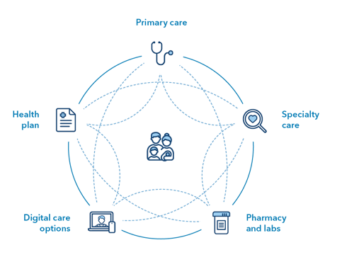
Kaiser Permanente Care designed to help you thrive
Primary care
It can be easier to find your healthy place with connected care
Health plan
Specialty care
We combine care and coverage:
Doctors
Hospitals
Health plan
Care can feel easier and faster and is centered around you.
Digital care options
Pharmacy and labs
Notes:
What to say:
We can help you get to your healthy place — no matter where it is.
We combine care and coverage — which makes us different than your other health care options. With Kaiser Permanente, you get:
Connected care — We’re both a care provider and a health plan, which makes your life easier. Your doctors, hospitals, and health plan work together — making it more convenient for you to get the right care when you need it. Your personal doctor, specialists, and nurses are connected to each other, and to you, through our electronic health record system. You get personalized care, because they can see your health history — like your conditions, medications, and allergies. Getting care feels easier and faster. Plus, referrals aren’t needed for certain specialties, like obstetrics-gynecology, mental health, and substance use disorder treatment. And when you need to see another type of specialist, your doctor can connect you.
Care meets you where you are — You have more ways to get care — by phone or video, online, or in person. At most of our facilities, you can see your doctor, get a lab test or an X-ray, and pick up prescriptions ― all without leaving the building. So, you can save time by doing more in one visit.
[mention dental and vision if applicable]

Slide 3
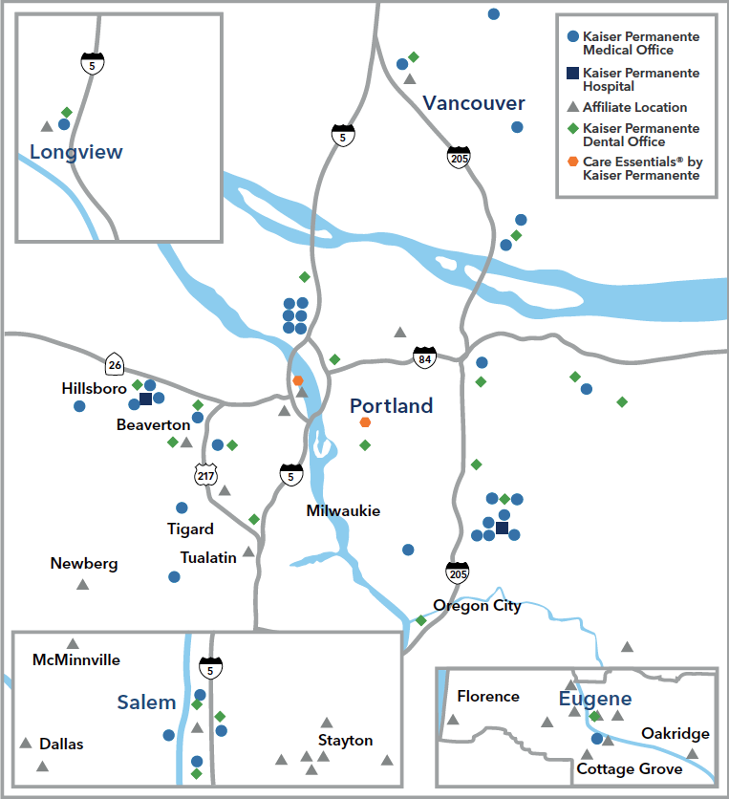
Kaiser Permanente Care designed to help you thrive
Kaiser Permanente Northwest
Care Near You
35 medical offices
6 urgent care clinics
6 Vision Essentials clinics
2 hospitals
2 Care Essentials® clinics
Affiliated hospitals and medical offices
Serving Oregon and Southwest Washington
Healthgrades Top 100 Hospitals
NCQA’s Best Health Plans
DiversityInc Top 50 Hall of Fame
Highest in customer loyalty 10 years in a row
Visit kp.org/locations to find your nearest facility
NCQA: No Plan Rated Higher for Private and Medicare Health Insurance Plan in Oregon and Washington. According to NCQA’s Medicare Health Insurance Plan Ratings 2011–2020 and NCQA’s Private Health Insurance Plan Ratings 2019–2020.
DiversityInc: Kaiser Permanente is recognized in DiversityInc Top 50 Hall of Fame for its ongoing commitment to diversity and inclusion. The criteria for the Hall of Fame is based on companies who have at one time ranked number one since the 2012 survey.
Satmetrix: For the 10th year in a row, Kaiser Permanente is number one in the health plan category for Customer Loyalty. Satmetrix, the co-developer of Net Promoter®, benchmarks leading brands according to their Net Promoter Score® (NPS).
Society of Thoracic Surgeons: Based on performance for adult heart bypass, aortic, and mitral valve replacement surgeries. Analysis of national data covering the period from July 2017 through June 2019.
publicreporting.sts.org/search/cabg_report_card/surgery_group?title=&field_year_target_id=11&field_state_value=OR
Notes:
We’re close by when you need us, with a service area that spans from Longview, Washington, to Eugene, Oregon.
We have 10 hospitals, 21 dental clinics, and 47 medical offices, including 12 medical offices through our collaborations with The Portland Clinic in Portland and PeaceHealth in our new service area in Eugene and Springfield.
New Facilities
Chase Gardens Medical Office in Eugene
NCQA: No Plan Rated Higher for Private and Medicare Health Insurance Plan in Oregon and Washington. According to NCQA’s Medicare Health Insurance Plan Ratings 2011–2020 and NCQA’s Private Health Insurance Plan Ratings 2019–2020.
DiversityINC: Kaiser Permanente is recognized in DiversityInc Top 50 Hall of Fame for its ongoing commitment to diversity and inclusion. The criteria for the Hall of Fame is based on companies who have at one time ranked number one since the 2012 survey.
Satmetrix: For the 10th year in a row, Kaiser Permanente is number one in the health plan category for Customer Loyalty. Satmetrix, the co-developer of Net Promoter®, benchmarks leading brands according to their Net Promoter Score® (NPS).
Society of Thoracic Surgeons: Based on performance for adult heart bypass, aortic, and mitral valve replacement surgeries. Analysis of national data covering the period from July 2017 through June 2019.
https://publicreporting.sts.org/search/cabg_report_card/surgery_group?title=&field_year_target_id=11&field_state_value=OR

Slide 4
Kaiser Permanente Care designed to help you thrive
Steps we are taking to help keep you safe
Telehealth options
Care through e-visits, video visits, email, and phone appointments*
Expanded mail-order pharmacy capacity
Emotional wellness online support resources
Online screening tool to assess your symptoms, see if you meet COVID-19 testing guidelines, and get scheduled for a COVID-19 test appointment as needed
www.kp.org/getcare
In-person care
Face masks required and provided if you don’t have one
Temperature screenings upon entry
Physical distancing with floor decals
Limited visitors
Increased cleanings
Staggering appointments to keep occupancy levels down
Virtual waiting rooms — wait in your vehicle until we are ready to see you
Curbside prescription pickup at select pharmacies
Financial and social health
Continuation of coverage after a layoff and medical financial assistance
Community support for essentials like housing, childcare, or food through Thrive Local
Timely communications with local updates and tips on how to stay well
*When appropriate and available. These features available when you get care at Kaiser Permanente facilities.
Notes:
To help keep healthy, Kaiser Permanente took several steps at the onset of the coronavirus outbreak. Each of these efforts leveraged our existing infrastructure, resources, and expertise.
Increasing telehealth services. To support physical distancing efforts and better protect the health of our members, we are utilizing our telehealth capabilities.
Expanding our mail-order pharmacy capacity. This helps to ensure our members can order even more prescriptions from home — by phone or online — and have their medicines shipped directly to their door.*
Online screening tool
Use our online screening tool to assess your symptoms and connect to care guidance, including online care from a Kaiser Permanente doctor.
Keeping patients safe
Masks are required for anyone who enters our buildings — both clinical and non-clinical areas. We will provide you with a nonmedical-grade mask to wear if you don’t have one. Patients with severe symptoms are isolated or hospitalized according to CDC guidelines.
Cleaning facilities
A healthy environment is essential for the safety of our members, visitors, doctors, and employees. We have strict cleaning procedures in place to disinfect our facilities and prevent the spread of COVID-19.
Testing and diagnosis — no cost
As a Kaiser Permanente member, you won’t have to pay for costs related to COVID-19 screening or testing if referred by a Kaiser Permanente doctor. If you’re diagnosed with COVID-19, additional services, including hospital admission (if applicable), will be covered according to your plan details.
Keeping you informed with timely communications. Especially right now, information and communication is essential. We’ve been actively communicating about how to stay healthy and access care. It’s a fluid situation, so we’re posting regular updates on kp.org and sending weekly email updates. These materials include evidence-based best practices for prevention and tips for staying active at home, as well as facts about the virus itself. We also provide updates on local facilities, changes in hospital policies, and how to access care from home.
Medical Financial Aid (MFA) & Continuing Coverage
If your coverage has changed due to a job loss or decrease in business, we’re here for you and your family. There are many ways to stay covered with Kaiser Permanente. To explore your coverage options or learn how to apply for financial help, visit kp.org/continue. For help with medical and pharmacy expenses, go to kp.org/mfa/nw.
Ensuring long-term access to care. No matter how long this pandemic lasts, we’re prepared. Kaiser Permanente has a business continuity plan and pandemic policy in place. We’ve also opened a national command center to prepare our staff and facilities for potentially large numbers of members who may become ill or are concerned they might be ill.
Community Support
We're here to support you however we can. If you need help with essentials like housing, childcare, or food, Thrive Local Connections can help connect you to resources in your community. Call 1-800-443-6328 (TTY 711), Monday through Friday between 8 a.m. and 5 p.m.
https://healthy.kaiserpermanente.org/oregon-washington/health-wellness/coronavirus-information
_____
*Some prescriptions are not available for refill by mail.

Slide 6
GETTING CARE
PHARMACIES
AND MAIL ORDER
Evidence-based
Rx management
Safety protocols
Convenience of mail-order pharmacy
Save a trip to the pharmacy
3-month supply for price of 2
Convenient refills at kp.org
6 | 2020 OPEN ENROLLMENT

Slide 7
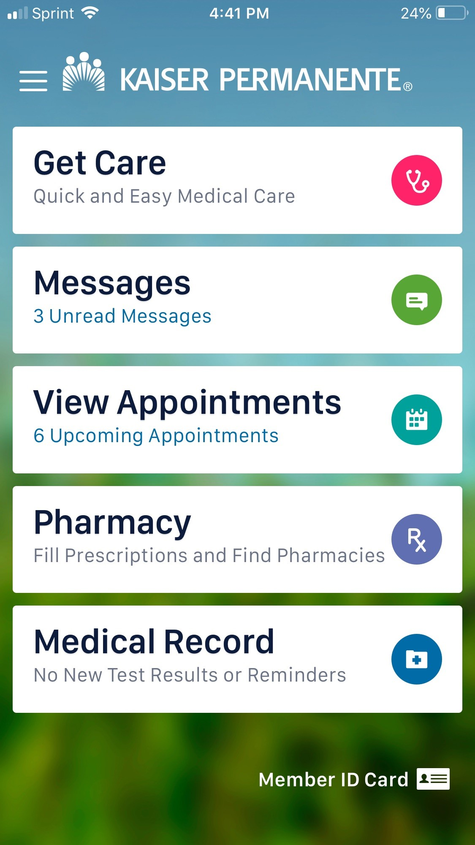
GETTING CARE
Download the app: m.kp.org
MORE HEALTH. LESS HASSLE.
Get online care, get care by phone, or schedule in-person care with a care provider.
View your bill, make a payment, and see payment history.
Email your doctor’s office with routine questions or check your messages — wherever you are.
Start an e-visit with a Kaiser Permanente doctor and get a treatment plan — including prescriptions — in less than an hour.
Make routine appointments for yourself and your family with easy-to-use scheduling tools.
Order prescription refills and view current medications.
View your medical record and check most test results.
7 | 2020 OPEN ENROLLMENT

Slide 8
Kaiser Permanente Care designed to help you thrive
Mental health services — care for the whole you
Your thoughts and feelings can affect your overall well-being. We’re committed to helping you achieve and maintain optimal health for your mind, body, and spirit.
Explore no-cost self-care tools, such as the Calm and myStrength apps,* to help manage anxiety and improve sleep, mood, relationships, and more at kp.org/selfcare.
Try an e-visit for anxiety, depression, and stress to get no-cost care in under an hour from a Kaiser Permanente clinician.
Your personal doctor knows you best — your medical history, preferences, beliefs, and lifestyle. They’re trained to diagnose common conditions like stress, depression, and anxiety and can connect you to the care that’s right for your needs.
Get support for a wide range of conditions, like anxiety, depression, substance use disorder, and autism spectrum disorders.
Learn more at kp.org/mentalhealth.
*Calm and myStrength are only available to Kaiser Permanente members with medical coverage; myStrength is a wholly owned subsidiary of Livongo Health, Inc.
Notes:
What to say:
Your mind and body are connected. What you think, feel, and do affects your total health. We’re committed to caring for the whole you — so you can achieve optimal health in mind, body, and spirit.
Kaiser Permanente provides clinical and support services for a wide range of conditions, including:
Anxiety
Stress
Depression
Substance use disorder
And autism spectrum disorders
Our mental health team also includes psychiatrists and psychologists, as well as marriage and family therapists, addiction medicine physicians, and medical social workers.
Practice self-care with the help of wellness resources like guided meditations.

Slide 9
HOW MEMBERS ACCESS CARE
GETTING CARE:
MENTAL HEALTH
9 | 2020 OPEN ENROLLMENT

Slide 10
How to Find an Alternative Care Provider
Visit www.chpgroup.com and click on green “Find a Provider” button
Plan (required): Choose Kaiser Permanente Self-Referred
How can I find out how much of my benefit I’ve used?
800-449-9479
info@chpgroup.com

Slide 11
Kaiser Permanente Care designed to help you thrive
New perks to help with your total health
ClassPass workouts
Get moving with fitness options that can fit your schedule and lifestyle, including Pilates, dance, boxing, cardio, strength training, and yoga.
Reduced rates on fitness classes: Real-time online and in-person classes from top fitness studios
Online video workouts at no cost: 4,000+ on-demand fitness classes
Calm app
Calm uses meditation and mindfulness to help lower stress, reduce anxiety, and improve sleep quality. Available at no cost to adult members.
A new 10-minute Daily Calm meditation every day
Guided meditations for anxiety, stress, gratitude, and more
Sleep Stories (soothing bedtime tales for grown-ups)
myStrength app
This personalized program has interactive activities to track current emotional states and ongoing life events to improve your awareness and change behaviors.
Tailored programs for managing depression, stress, anxiety, and more
Mindfulness and meditation activities
Tools for setting goals, tracking emotional states, and monitoring progress
Notes:
What to say:
Take advantage of these new membership perks to help you stay physically and mentally fit.
ClassPass at-home workouts
Get moving with fitness options that fit your schedule and lifestyle.
Reduced rates on livestream and in-person fitness classes like Pilates, dance, and boxing from top fitness studios
Access 4,000+ on-demand fitness classes online, including cardio, strength training, and yoga
Calm app
Calm uses meditation and mindfulness to help lower stress, reduce anxiety, and improve sleep quality. Available at no cost to adult members. The app offers something for everyone:
A new 10-minute Daily Calm meditation every day
Guided meditations for anxiety, stress, gratitude, and more
Soothing bedtime tales for grown-ups
Music for focus, relaxation, and sleep
Calm Masterclasses taught by world-renowned experts and celebrities
myStrength
Increase emotional resilience and adaptability with this app-based wellness program. You can create a personalized routine that includes:
Tailored programs for managing depression, stress, anxiety, and more
Mindfulness and meditation activities
Tools for setting goals, tracking emotional states, and monitoring progress

Slide 12
Kaiser Permanente Care designed to help you thrive
City of Salem – Kaiser Permanente $250 Deductible Plan
This table shows an example of some of your group’s benefits.
Yearly deductible | $250 individual/$750 family
Maximum yearly out-of-pocket costs | $1,250 individual/$3,750 family
Covered service | You pay
Preventive care | $0 copay
Telehealth (phone/video/e-visit) | $0 copay
Doctor’s office visit — primary and specialty | $15 copay (primary) / $25 copay (specialty)
Urgent care | $15 copay
Lab tests and imaging | $10 copay
Outpatient surgery | 20% coinsurance after deductible
Hospitalization | 20% coinsurance after deductible
Emergency care | 20% coinsurance after deductible
Prescribed medications (30-day supply) | $10 copay (generic)/$20 copay (preferred brand-name)/$50 (non-preferred brand-name)
*This is a summary of some benefits and their copays and coinsurance. For specific information about your covered health plan benefits, limitations,
and exclusions, including those not listed in this summary, please see your Evidence of Coverage.
Notes:
Note to presenter:
If you choose to include this slide, make sure to fill in the plan name at the top and all the variable fields.

Slide 13
Kaiser Permanente Care designed to help you thrive
Self-Referred Alternative Care Benefit
This table shows an example of some of your group’s benefits.
Benefit maximum | $1,000 individual
Covered service | You pay
Acupuncture | $10 copay
Chiropractic | $10 copay
Massage | $25 copay (up to 12 visits per calendar year)
Naturopathy | $10 copay
Find a provider: chpgroup.com
*This is a summary of some benefits and their copays and coinsurance. For specific information about your covered health plan benefits, limitations,
and exclusions, including those not listed in this summary, please see your Evidence of Coverage.
Notes:
Note to presenter:
If you choose to include this slide, make sure to fill in the plan name at the top and all the variable fields.

Slide 14
Meet your Engagement Specialist…
Rocio Acosta, MHA, CPhT
Bilingual Engagement Specialist II
Get the most from your health plan. Call me to discuss:
• Benefit Questions
• Transferring Care
• Finding a Provider
• How to get Started
Have questions about your medical options this Open Enrollment season? Schedule a 1 on 1 phone appointment with me to address your questions. Office hours from:
Tuesday, October 27th – 2:00pm – 4:00pm
Thursday, October 29th – 10:00am – 12:00pm

Slide 15
Kaiser Permanente Care designed to help you thrive
A positive experience from the start
We help guide you through each step of joining Kaiser Permanente, so you can start getting the care you need from day one.
Onboarding support
Receive a personalized welcome book in the mail and access our New Member Welcome Desk.
3 easy steps toward a healthy change
Register on kp.org.
Transition your care and prescriptions.
Choose a care team and schedule your first appointment.
Learn more at kp.org/newmember or call the New Member Welcome Desk at 1-888-491-1124.
Notes:
What to say:
As soon as you join, we want to make your care experience easier.
Onboarding support —You’ll get your ID cards and a personalized welcome book in the mail. Still have questions? Call our New Member Welcome Desk for 1:1 support in transitioning your care to Kaiser Permanente.
Start getting the care you need in 3 easy steps.
Registration on kp.org ― Register for your online account on the Kaiser Permanente app or kp.org/new member and start using the many time-saving features. Schedule virtual or in person appointments, order and track prescriptions, and manage your family’s care.
Transition your care and prescriptions ― Easily move prescriptions so your treatment is uninterrupted. And find a care location that’s close to your home, work, or school.
Choose your care team ― You can browse doctors by location and see details about their education, specialties, languages spoken, and more online. Choose your doctor based on what’s important to you and change anytime.

Slide 16
THANK YOU
Member Services:
1-800-813-2000 (TTY 711)
kp.org/newmember
16 | 2020 OPEN ENROLLMENT

