Slide 1
City Of Salem
Dental Benefits

Slide 2
Delta Dental Premier Network
Our contracts are what controls costs.
Premier providers
Paid at in-network benefit level
Members are held harmless from balance bills
90% of dentists in Oregon and 79% of dentists nationally are in our Premier network
Non-contracted providers are paid at the out of network benefit level; members may be balance billed

Slide 3
Constant Plan Benefit Summary
Plan year costs
Plan year Maximum, per member (Class 2 & Class 3) | $1,500
Plan year deductible, per member | $0
Class 1 (services do not apply to the plan year maximum)
Periodic Examinations / X-rays | 100%
Prophylaxis (cleanings) / Periodontal Maintenance | 100%
Sealants | 100%
Space Maintainers | 100%
Topical Application of Fluoride | 100%

Slide 4
Constant Benefit Summary (continued)
Class 2
Restorative Fillings | 80%
Oral Surgery (extractions & certain minor surgical procedures) | 80%
Endodontics (treatment of teeth with diseased or damaged nerves) | 80%
Periodontics (treatment of diseases of the gums and supporting structures of the teeth) | 80%
Class 3
Implants | 60%
Crowns and other cast restorations | 60%
Dentures and bridges (construction or repair of fixed bridges, partial, and complete dentures) | 60%

Slide 5
Constant Plan Orthodontia Coverage
Lifetime maximum | $1,000
 | What members pay
Members age 19+ | 50%
Members under age 19 | 50%

Slide 6
Incentive Plan Benefit Summary
Plan year costs
Plan year Maximum, per member | $1,000
Plan year deductible, per member | $0
Class 1
Periodic Examinations / X-rays | *1st year – 70% 2nd year – 80% 3rd year – 90% 4th year – 100%
Prophylaxis (cleanings) / Periodontal Maintenance | 100%
Sealants | 100%
Space Maintainers | 100%
Topical Application of Fluoride | 100%
*Under this plan, payments increase by 10% each eligibility year provided the individual has visited the dentist at least once during the year. Failure to do so will cause a 10% reduction in payment the following year, although payment will never fall below 70%.

Slide 7
Incentive Benefit Summary (continued)
Class 2 & 3
Restorative Fillings | *1st year – 70% 2nd year – 80% 3rd year – 90% 4th year – 100%
Oral Surgery (extractions & certain minor surgical procedures) | 80%
Endodontics (treatment of teeth with diseased or damaged nerves) | 80%
Periodontics (treatment of diseases of the gums and supporting structures of the teeth) | 80%
Crowns and other cast restorations
Class 4
Implants | 50%
Dentures and bridges (construction or repair of fixed bridges, partial, and complete dentures) | 50%
*Under this plan, payments increase by 10% each eligibility year provided the individual has visited the dentist at least once during the year. Failure to do so will cause a 10% reduction in payment the following year, although payment will never fall below 70%.

Slide 8
Incentive Plan Orthodontia Coverage
Lifetime maximum | $1,000
 | What members pay
Members age 19+ | 50%
Members under age 19 | 50%

Slide 9
Oral Health, Total Health
If you are diabetic or pregnant in your third trimester, the Oral Health, Total Health program offers more ways to care for your teeth and mouth and keep the rest of your body healthy, too
Diabetes increases the risk of cavities, periodontal (gum) disease, tooth loss, dry mouth and infection
Pregnant women who have periodontal (gum) disease are more likely to have a premature and underweight baby
Added benefit of additional cleanings
Easy to enroll

Slide 10
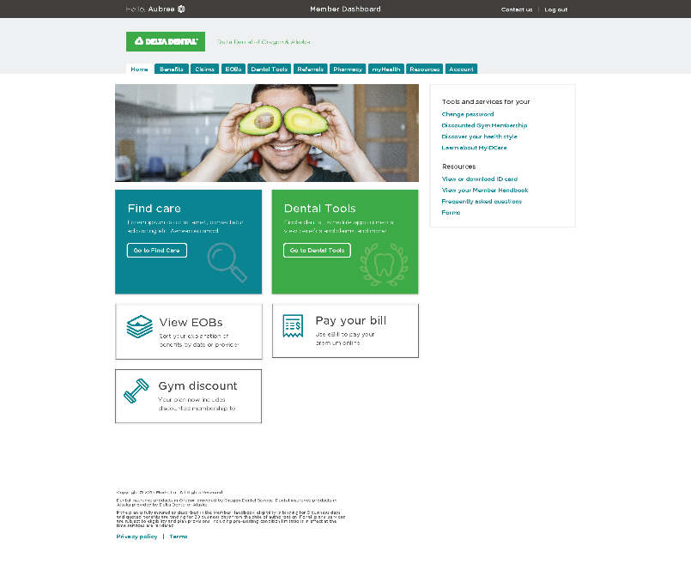
Member Dashboard
Visit Member Dashboard at DeltaDentalOR.com
Take dental health evaluations and risk assessments
View your EOBs & claims in real time
View complete member handbook
Download and print ID cards
Access Cost Calculator
Set up electronic EOBs

Slide 11
Questions?
We are here to help!
Please contact our Dental Customer Service team at:
888-217-2365 or CustomerSupportOR@deltadentalor.com

